Slide 1

(B) Data Processing

Slide 2

Example cases
Your data includes observations from 2015 to 2019, but you want use a subset of data (based on certain variables).
Analysis goal is the effect of age of “lower than 20 or higher than 20” and “lower than 40 and higher than 40”. But, your data includes continuous age variable.

Slide 3
What is data processing?
A series of operations on data to retrieve, transform, or classify data information (from dictionary). – Very useful for your analysis!
In this session,
Check data (understand how your data looks like…).
Select a subset of data.
Missing values (How to find missing values, and how to impute them…).
Transforming data (e.g., continuous variables to discrete variables).

Slide 4

Restaurant Sales data
This is a transaction-level sales data in a restaurant in Florida for one year (we are using only small sample for our practice).
The data includes: time (year, month, day and hour). Table id, Menu, Price of each menu, approximate calories.

Slide 5
Professor Salary Data
I found this data from R practice data Website
I don’t know if this data includes real salary information of professors or not… ☺ But, I thought this data looks good for our R practices. So I choose this.
https://vincentarelbundock.github.io/Rdatasets/doc/carData/Salaries.html

Slide 6
Topic 1 in Workshop (B): Import and export data file
You can use multiple types of data in R, but we will use “.csv” type files in this Workshop and our marketing analytics class.
Change directory: setwd(“C:/”) is convenient before analysis.
Import data and export data examples in R.
Assign (simple and recognizable) any file name for the imported data:
E.g., Store1<-read.csv(“store-df.csv”)

Slide 7
Practice: Topic 1 in Workshop (B): Import and export data
Export the R_data as a different name of "R_data_1" as csv file or R data format (RDS). Also, import the exported RDS data.

Slide 8
Topic 2 in Workshop (B): Check the imported data file
Check dimension (size) of the data.
See only first row of the imported data.
What variables (columns) are available in the data?
See summary of data
Use str() : Compactly display the internal structure of an R object
How to understand the summary report of your data?
We can see range, quantiles and mean values per column

Slide 9
Practice: Topic 2 in Workshop (B):
If you have many columns in your data, summary report provides too many information…
Without using ‘summary’ report, what are minimum and maximum price of the menus?
Without using ‘summary’ report, what are median and mean values of the Calories?

Slide 10
Topic 3 in Workshop (B): a subset of data
This is very useful for data transformation
Select some columns of the data
Select one column of the data
Select multiple columns of the data
Exclude one (or multiple) column(s) of the data
Select some rows of the data
Create a new dataset with the menus with any conditions (e.g., menus of which prices are higher than $7).

Slide 11
Practice: Topic 3 in Workshop (B): a subset of data
Generate a subset data with calories 500 or higher. what is mean price of the new subset data?
Generate a subset data only with Cobb Salad and Omelet.

Slide 12

The ‘dplyr’ package in R
The ‘dplyr’ is an R-package that is used for transformation and summarization of tabular data with rows and columns.
It includes a set of functions that filter rows, select specific columns, re-order rows, adds new columns and summarizes data.
Compared to base functions in R, the functions in ‘dplyr’ might have an advantage in the sense that they are easier to use, more consistent in the syntax, and aim to analyze data frames instead of just vectors.
I don’t personally use this much because I am doing my own coding for data processing. But, it is up to you… I think this is a very useful package…

Slide 13
Topic 4 in Workshop (B): Data processing examples with ‘dplyr’ package
For example, If I need to use a subset of data with ‘hour’ and ‘calories’ columns.
If I want to use a subset of data of price is $7 or higher…
You can use your own coding or you can use this package. You can search more online about his package…
C.F.,
https://cran.r-project.org/web/packages/dplyr/dplyr.pdf
https://cran.r-project.org/web/packages/dplyr/vignettes/dplyr.html

Slide 14
Practice: in Workshop (B): dplyr application practice – search it for yourself
(Restaurant Data) Using ‘dplyr’ package, select rows 30 to 50 and print to console its Price and Calories.
(Professor Data) Using ‘dplyr’ package, count how many Female professors are in discipline B?
(Professor Data) Using ‘dplyr’ package, filter out a subset of professors between the ‘yrs.since.phd’ 10 and 20 and calculate the proportion of Male?
Again, there are so many way for doing this but let’s use ‘dplyr’ in this practice!

Slide 15
Topic 5 in Workshop (B): Check objects
Once we get (or download) a dataset, we frequently have some strange results. Many possible reasons… e.g., missing values or data object format is different from our assumption (expectation).
You have to check the format object is what you expect (e.g., numeric, factor, character)… This is simple but sometimes very critical.
You can convert your object (e.g., from numeric to factor), if you really need…
Notes:
We covered this before… but it’s good to review in the data transformation section…

Slide 16
Topic 6 in Workshop (B): Missing Values
Data frequently include missing values and they can make errors.
Find missing values (diagnostics)
Impute the missing values: if there are too many missing values, you have to be careful… → Imputation means estimate (i.e., guessing) most “likely” value using other data points.
You have to report the proportion of missing values – we will use R package ‘mice’ in this class.
Imputation techniques provide multiple datasets (i.e., estimating missing values with estimation with random number generation).

Slide 17
Practice: in Workshop (B): Missing Values
Use data ‘Prof_Salaries_missing.csv’
Search missing values per column without package (hint, use ‘is.na’ command in R or you can search any possible commands in Website…)
Notes:
I can directly show solution for this practice…

Slide 18
Topic 7 in Workshop (B): Create new columns.
Let’s use the imputed (professor salaries) data from previous step.
Create a new data column of discrete variable from continuous variable.
E.g., Salary variable to ordinal salary or binary salary. Sometimes, it’s easy to interpret.

Slide 19
Practice: in Workshop (B): Create new columns in dataset
Let’s keep using the imputed (Professor Salary) data for this practice.
Create 5 level ordinal variable with prof salary column: Use 5 quantile values (i.e., .2, .4, .6, .8, and 1). Now, what is a mean difference of service years of the group salary level = 1 vs. the group salary level = 5?

Slide 20
Topic 8 in Workshop (B): Add small error on discrete variable
There are some cases you need to add some (small) random errors
You need to add some (small) random errors for simulation data generations: E.g., for simulation study, simulated data (in real world) needs to include some errors.
Sometimes, if you have error with discrete variable, it is helpful add small continuous error (e.g., small random errors from normal distribution) for avoiding model estimation error.
Data core pattern should be basically same, but it can do ‘smoothing’ for your data.
But, be careful! If you add too much error, your data can be different from your original data.

Slide 21
A Session Ending Challenging Practice!
Work this practice as a team. Once any team finish, please come to front and explain your answer! I have a small prize (e.g., cookie ☺).
Use the data set of ‘WData_R Workshop2019_EndingChallenge’ which includes sales data of a restaurant for March 2016.
Please create a new dataset with hourly sales data per date (e.g., 3 columns : date, hour, sales)...
(Hint) sales = sum of all prices at the hour
When was max sales (i.e., what hour of which date)?

Slide 22
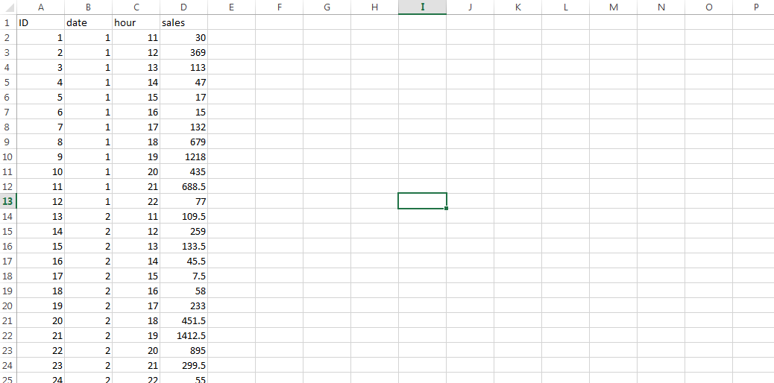
Something like this… ☺

